Slide 1
Δρ Αικατερίνη Πολυμέρου-Καμηλάκη
πρώην διευθ., επιστ. συνεργάτις
του Κέντρου Λαογραφίας της Ακαδημίας Αθηνών
Ο Λαϊκός Πολιτισμός σήμερα
Μέρος 5ο

Slide 2
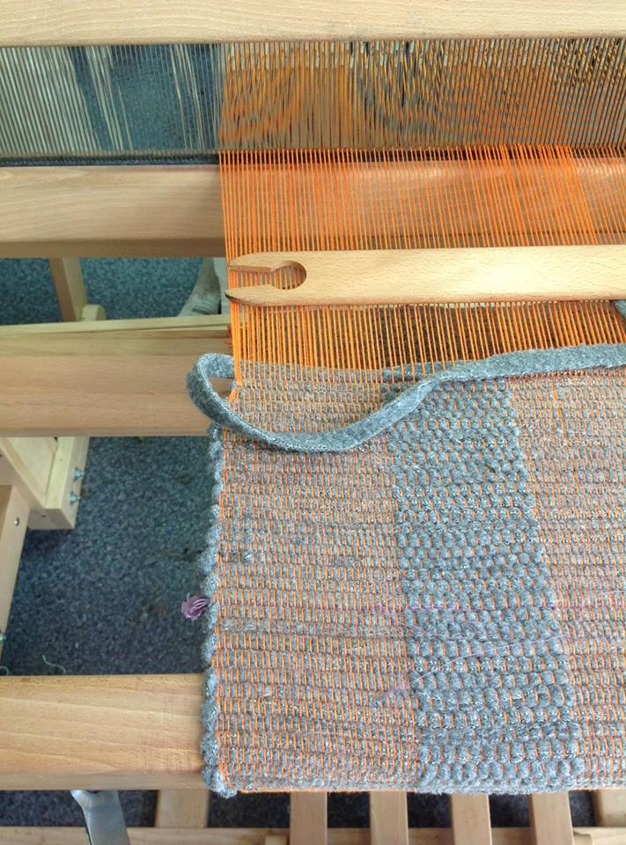
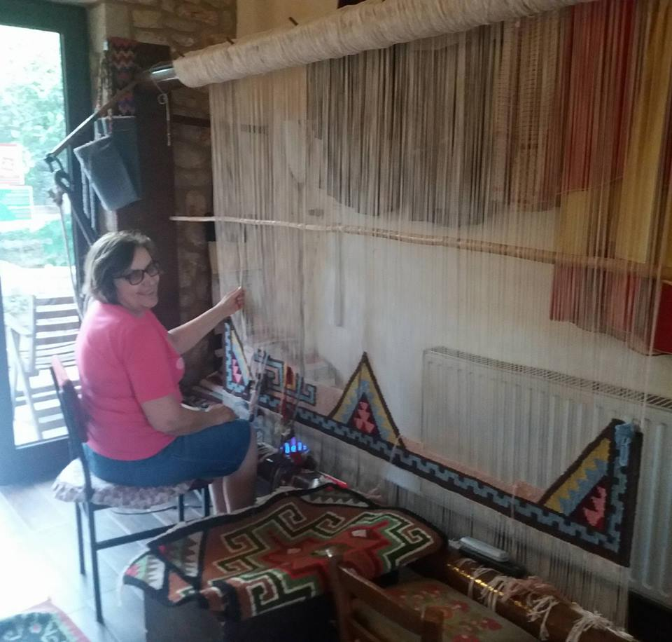

Slide 3
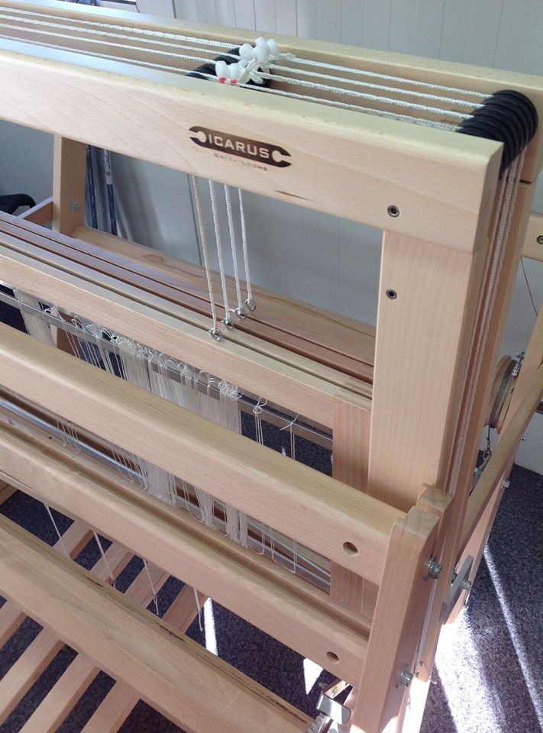
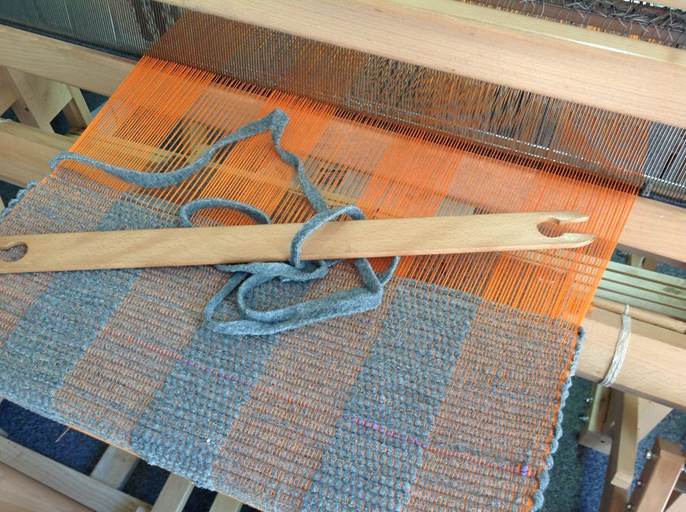

Slide 4
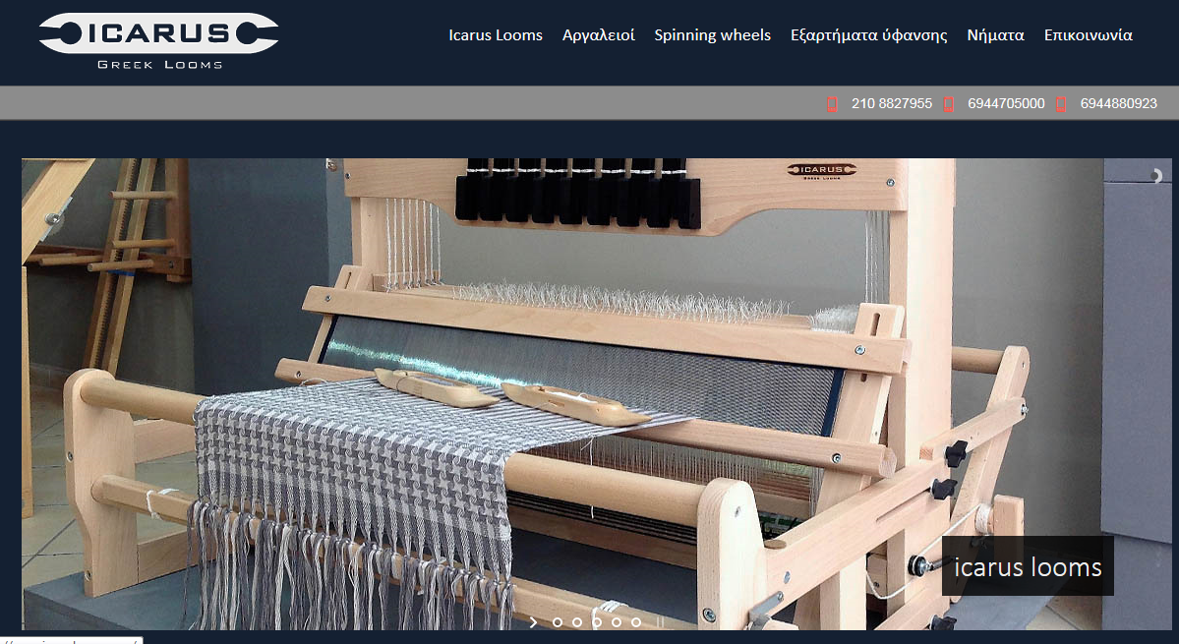
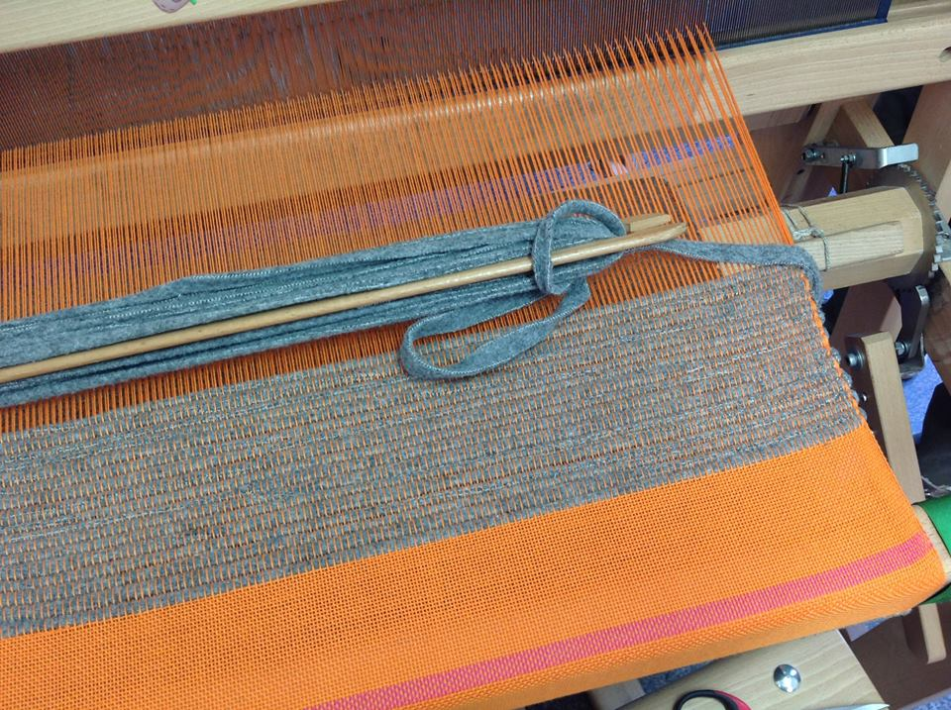

Slide 5
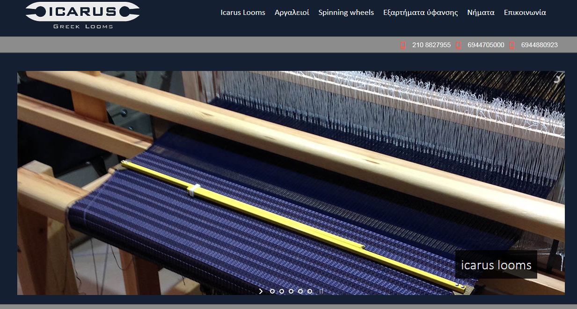

Slide 6
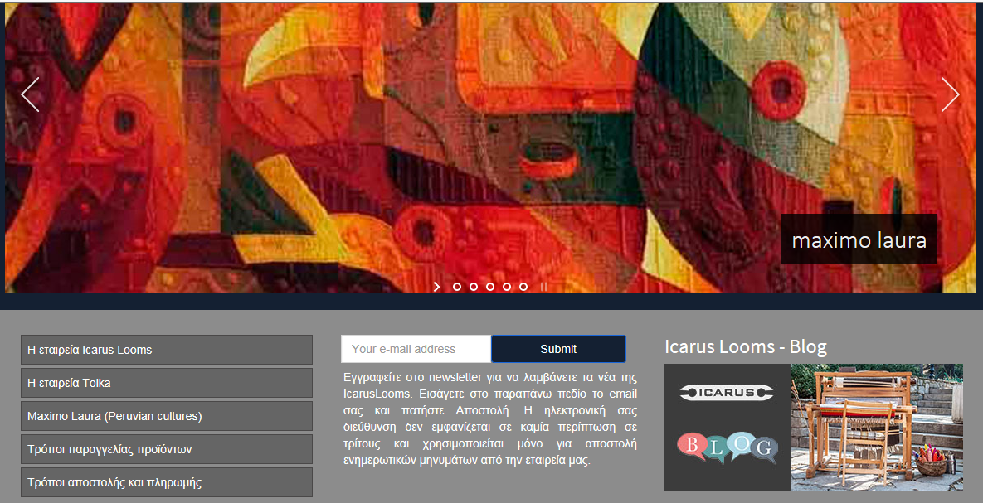

Slide 7
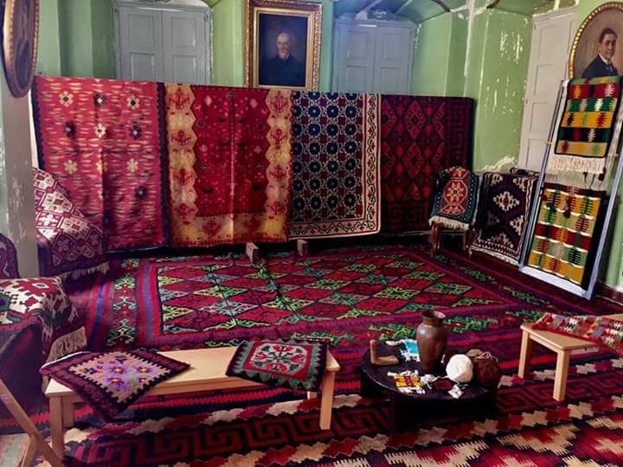

Slide 8
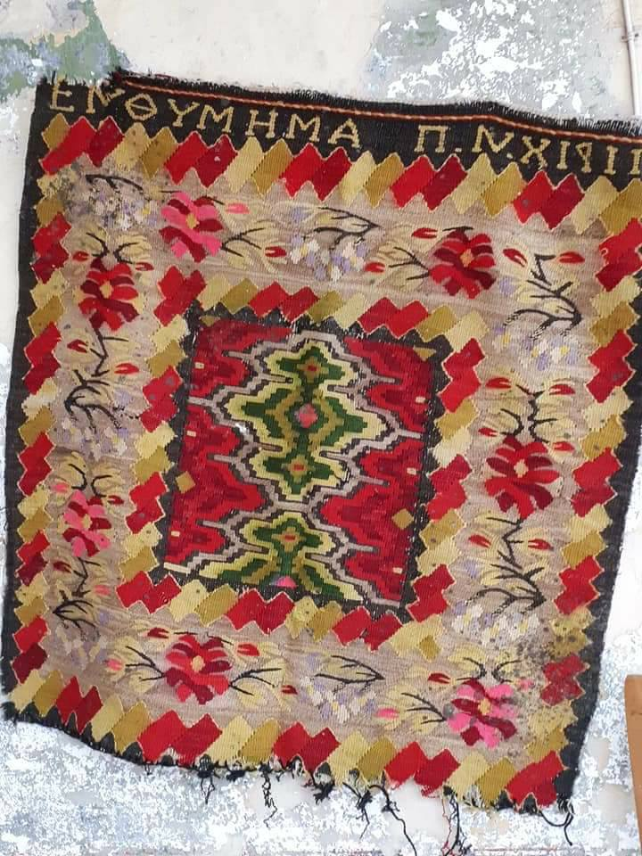

Slide 9
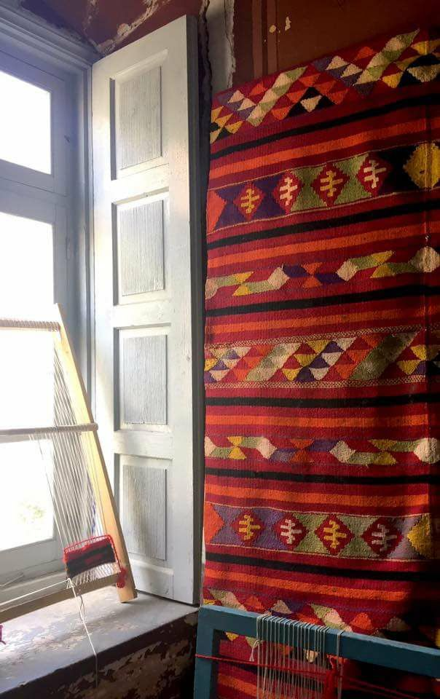
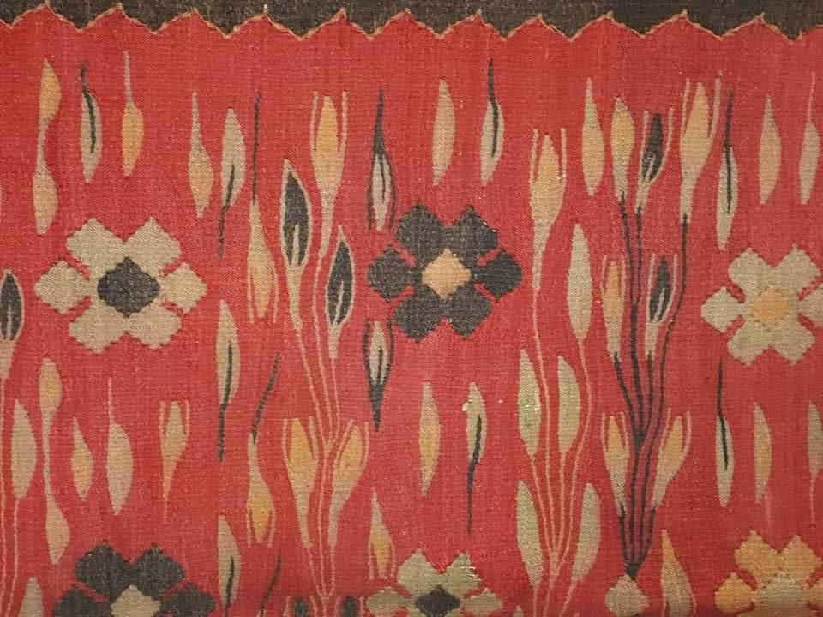

Slide 10
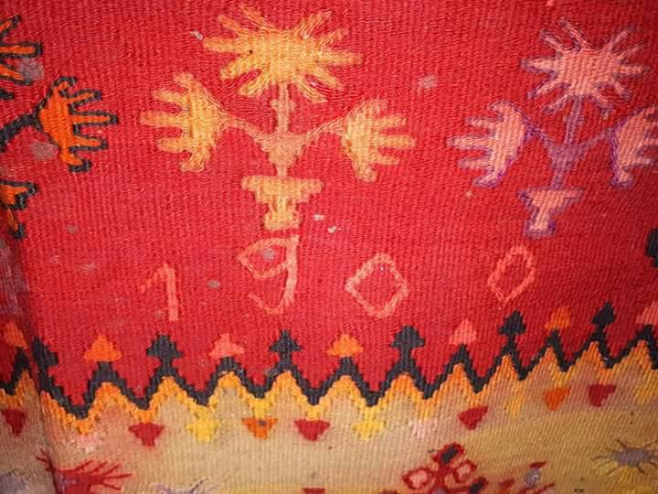

Slide 11
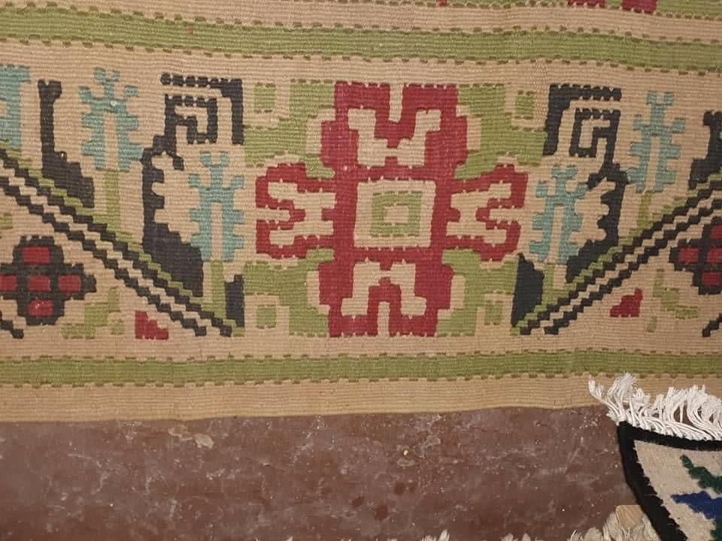

Slide 12
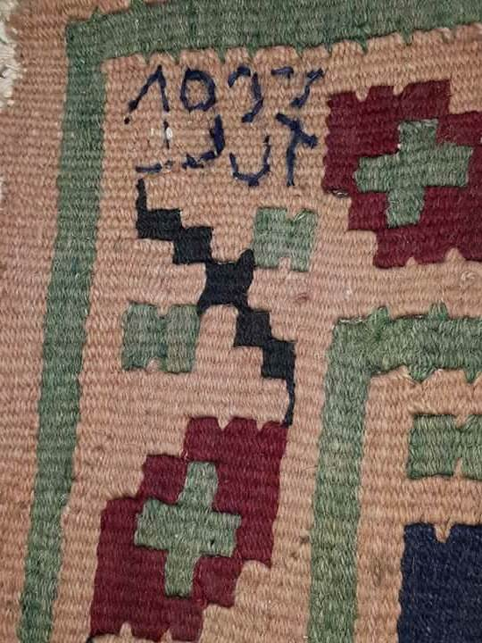

Slide 13
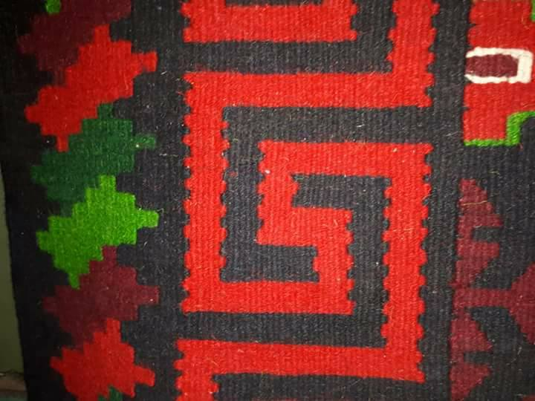

Slide 14
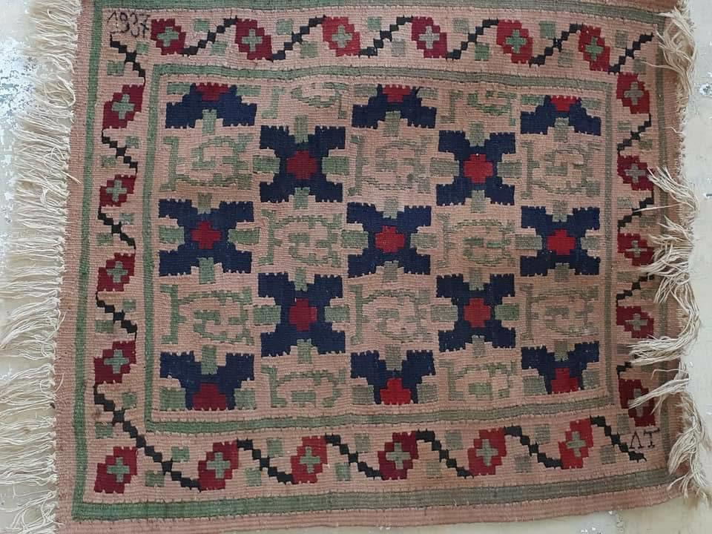

Slide 15
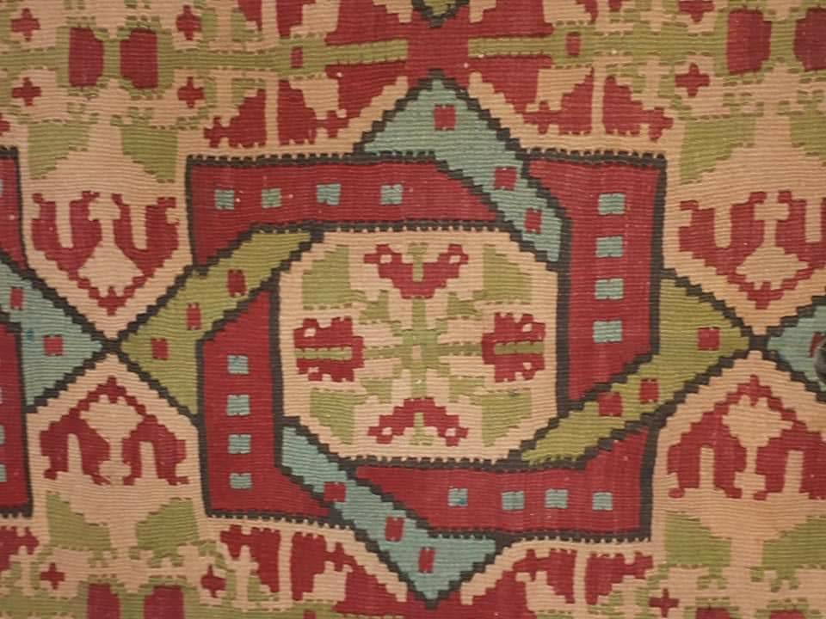

Slide 16
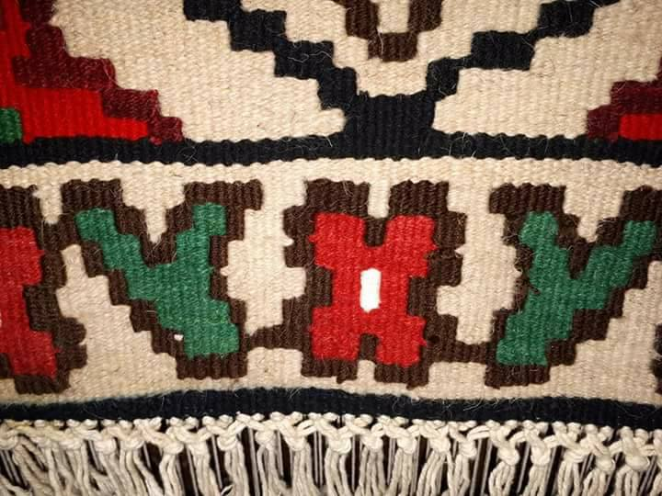

Slide 17
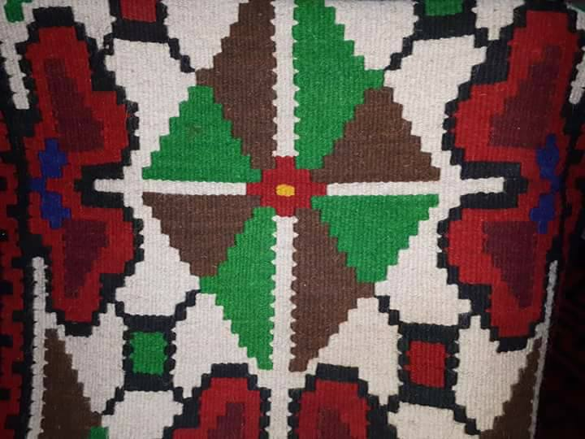

Slide 18
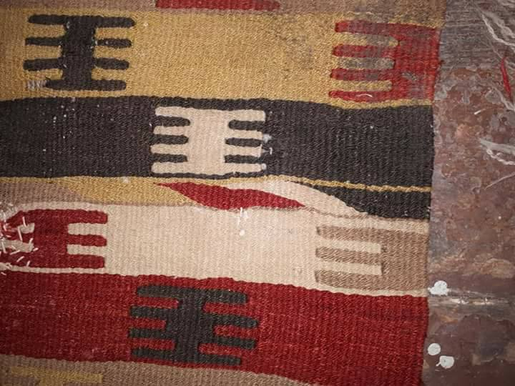

Slide 19
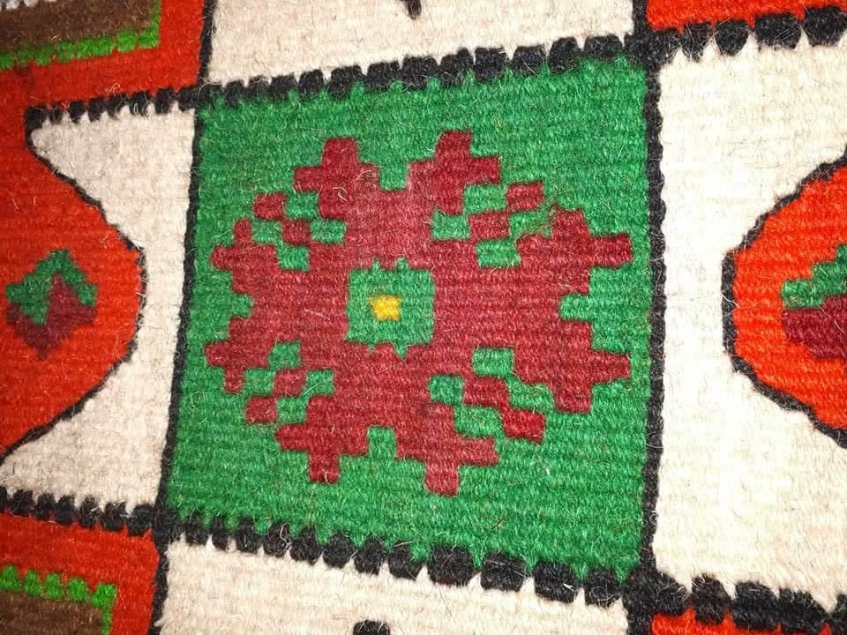

Slide 20
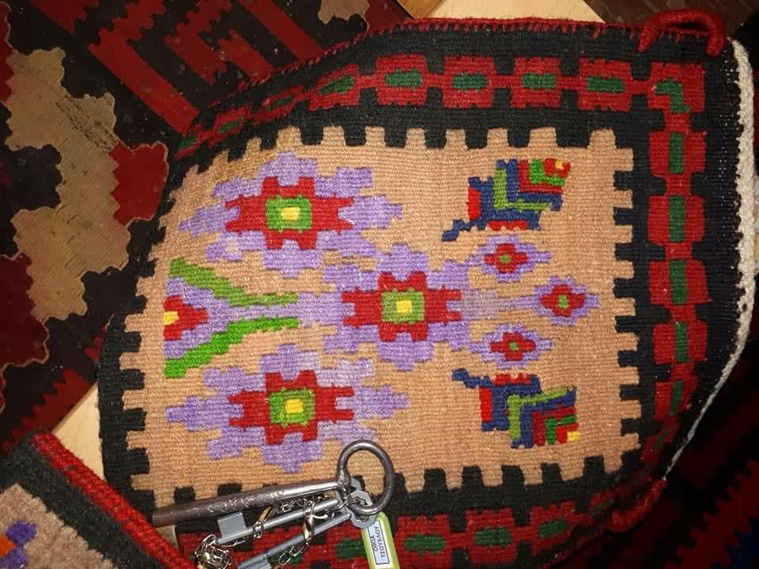

Slide 21
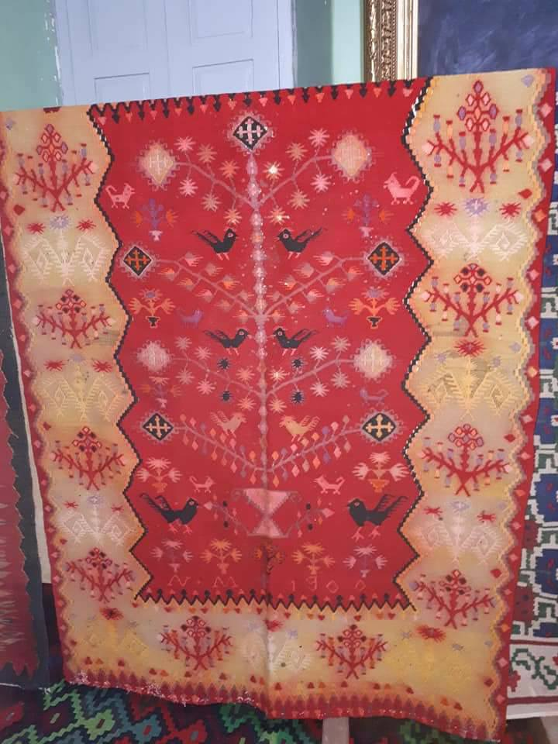

Slide 22
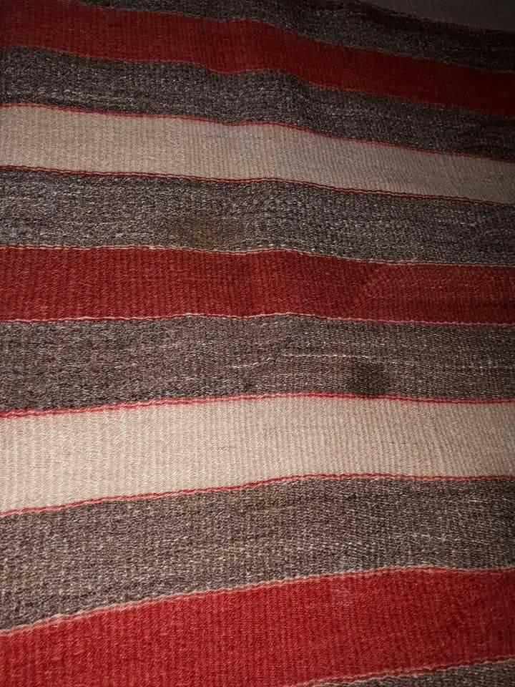

Slide 23
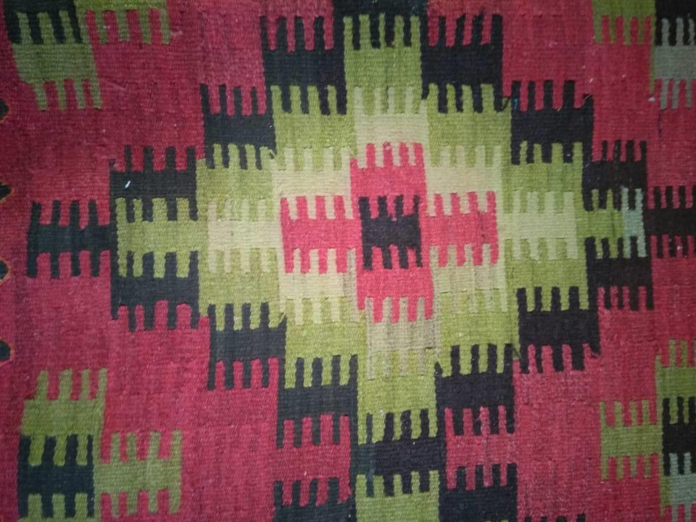

Slide 24
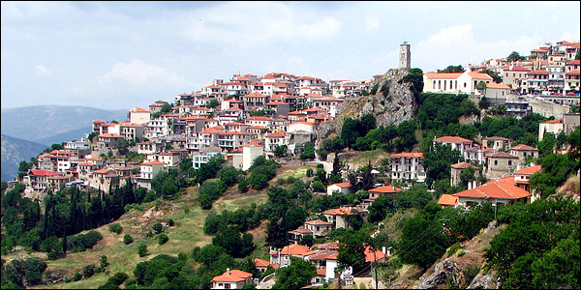
Αράχοβα

Slide 25
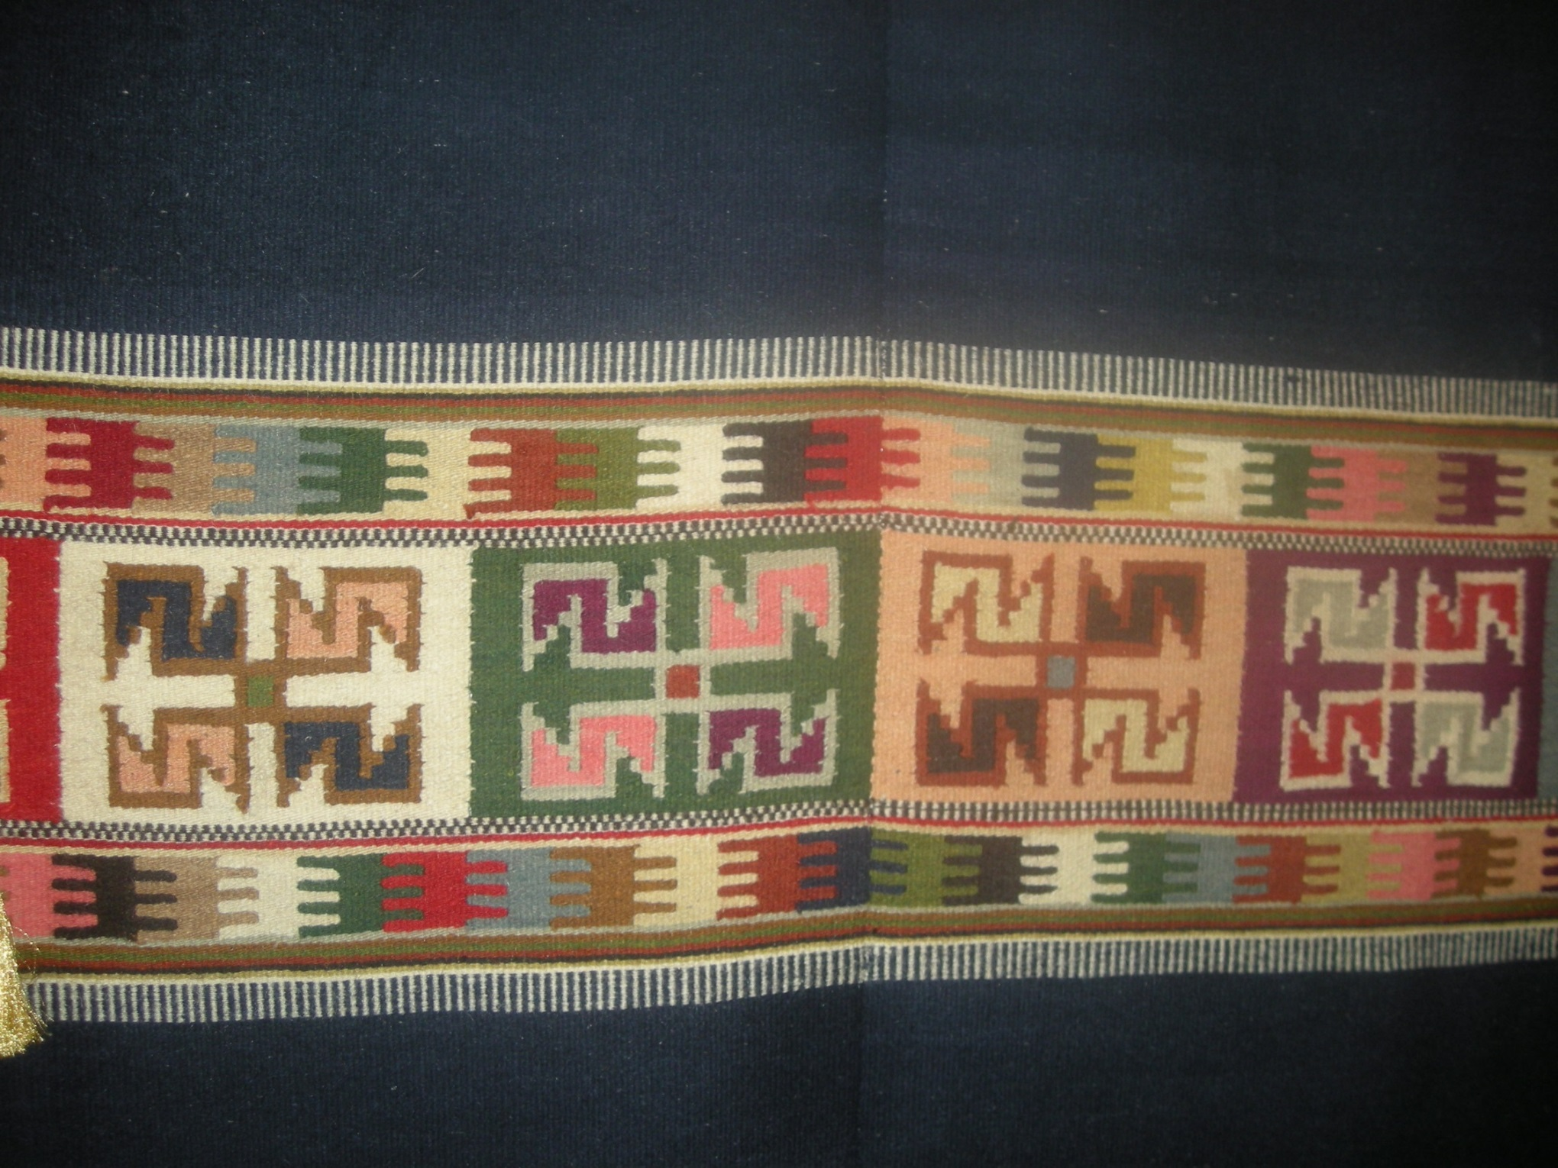

Slide 26
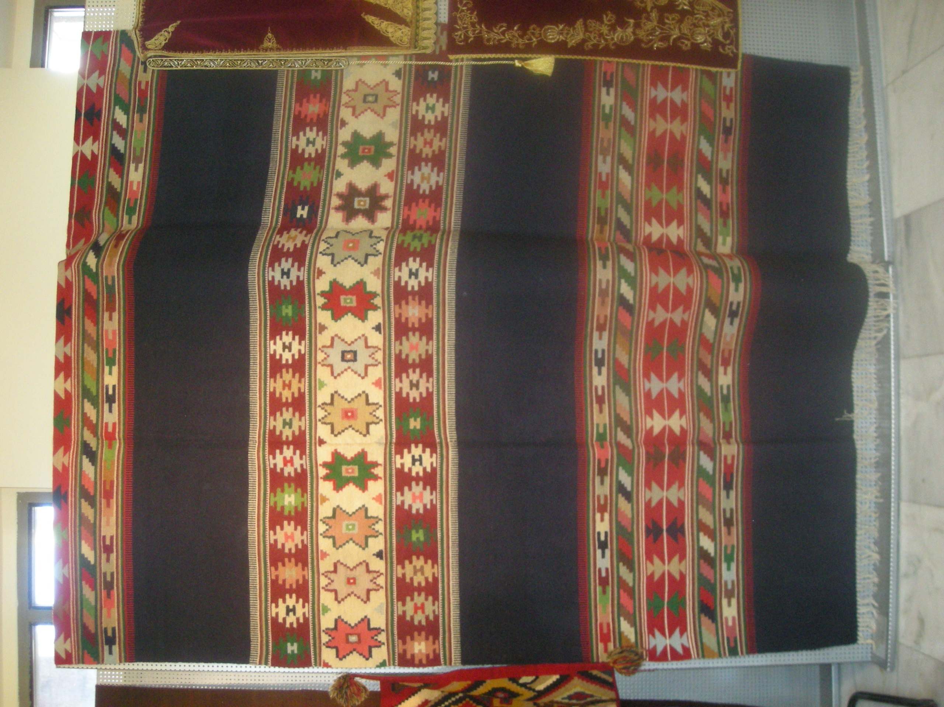

Slide 27
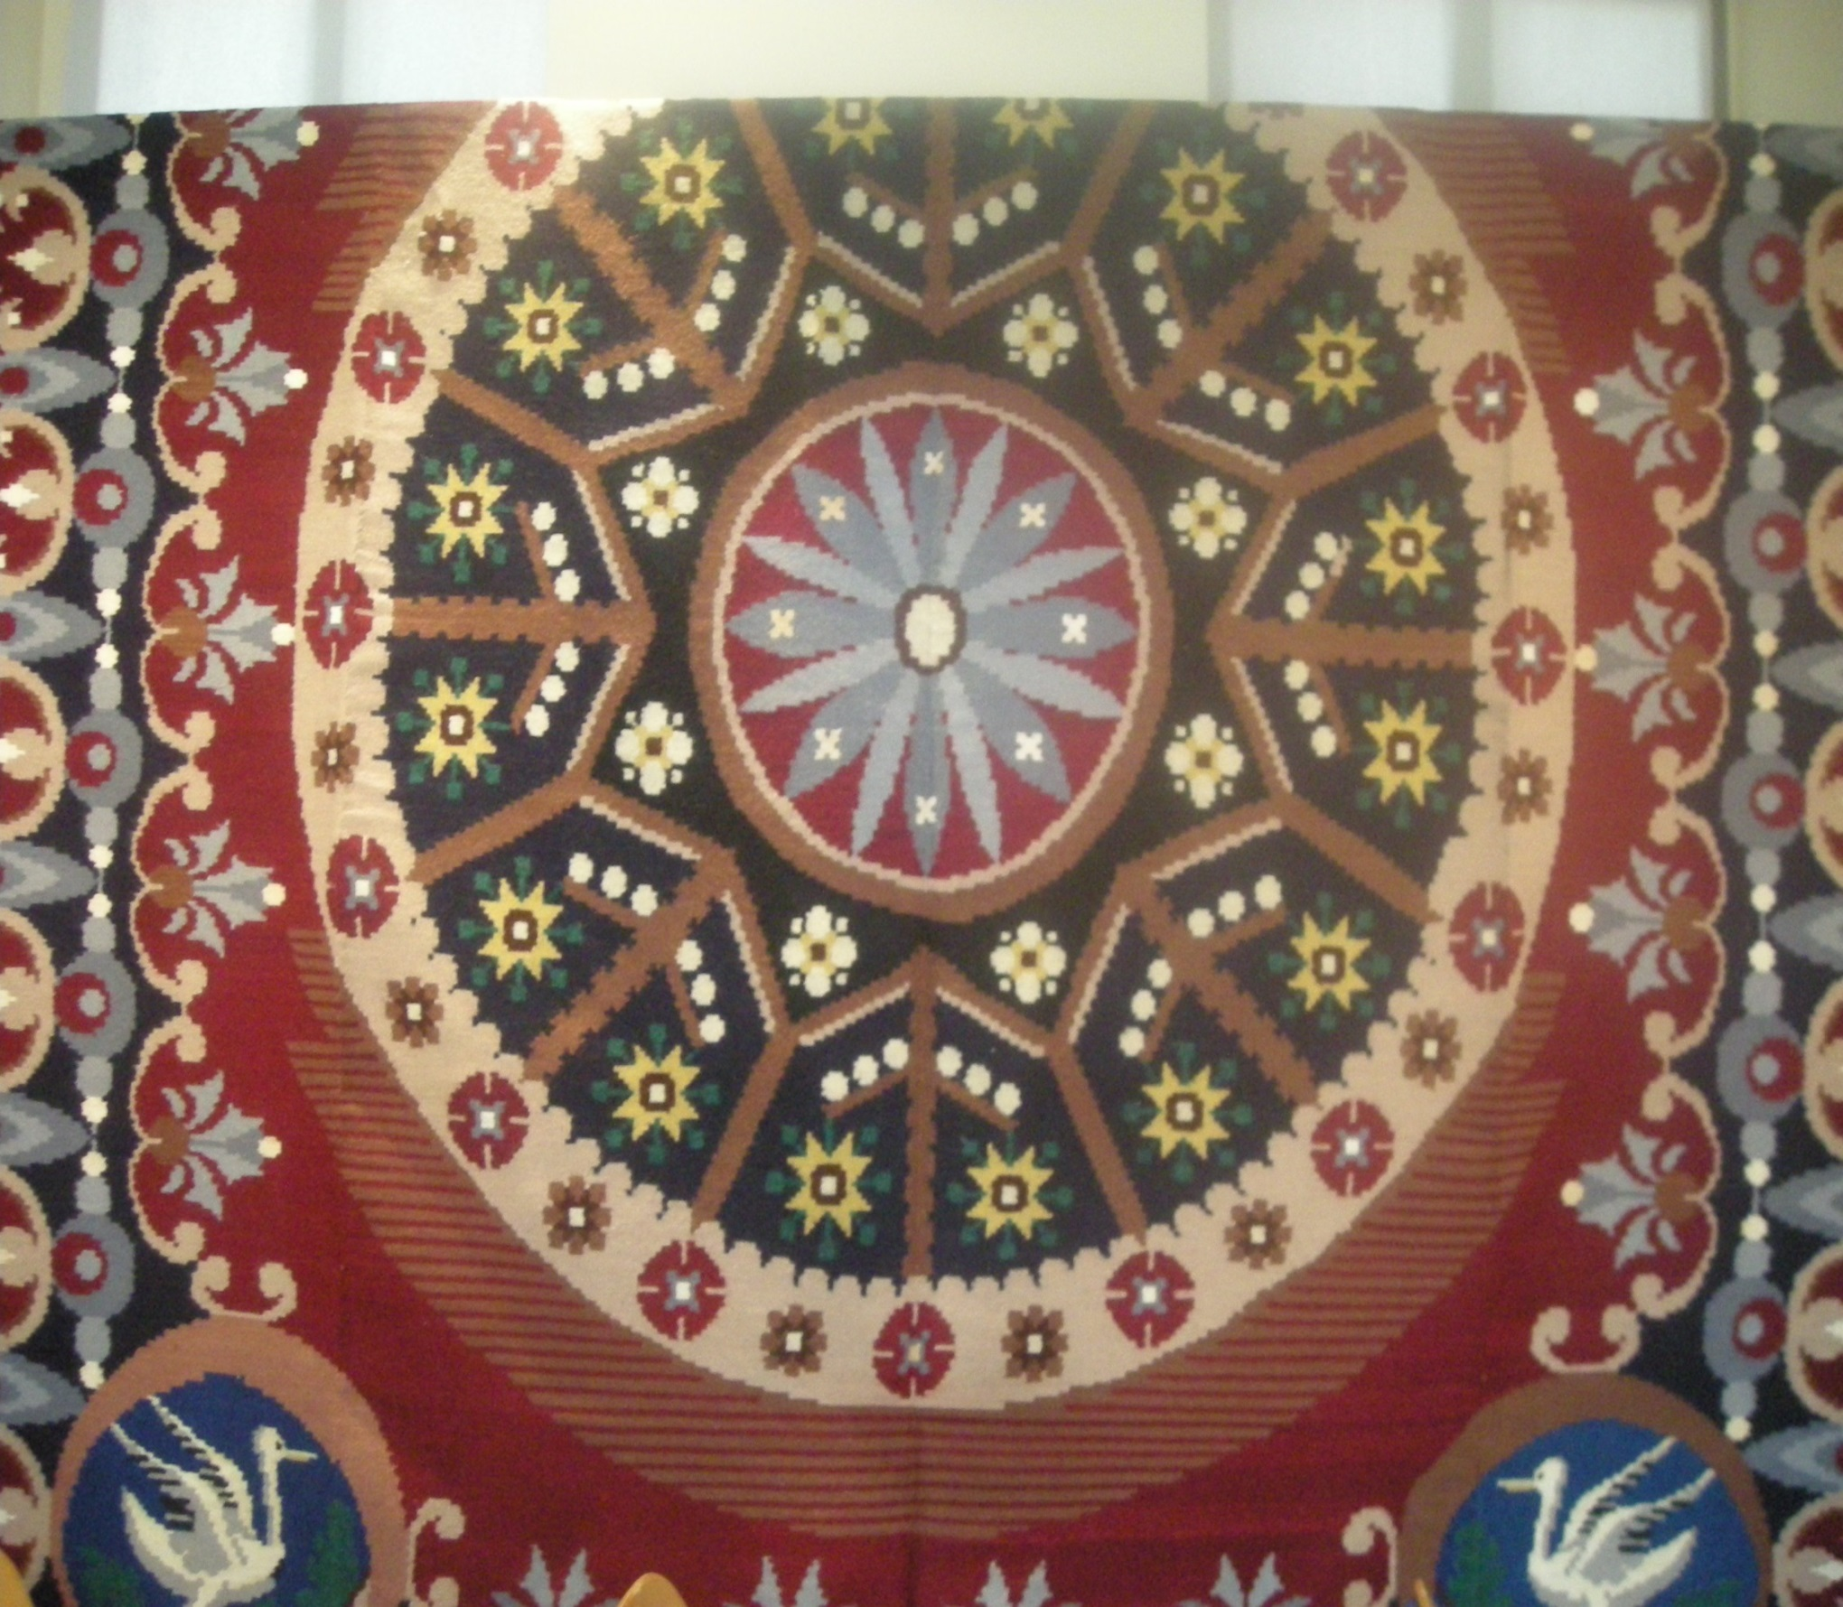

Slide 28
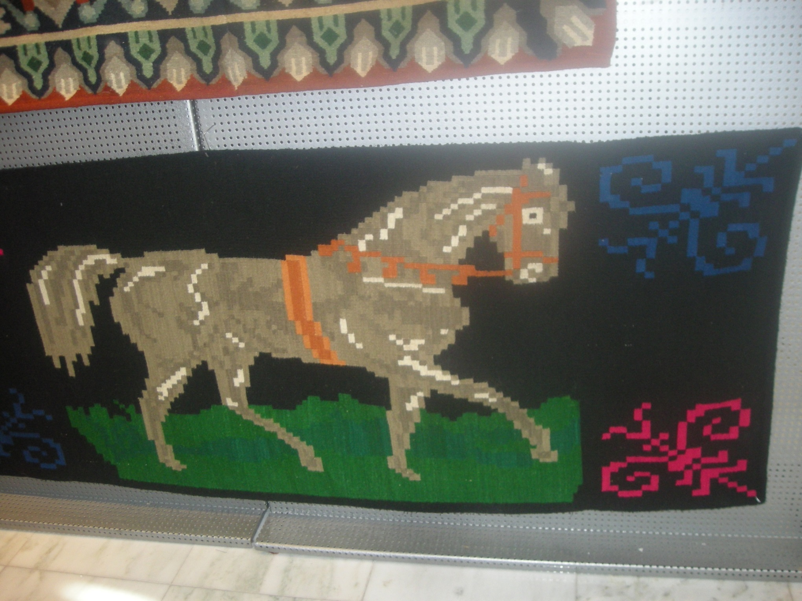

Slide 29
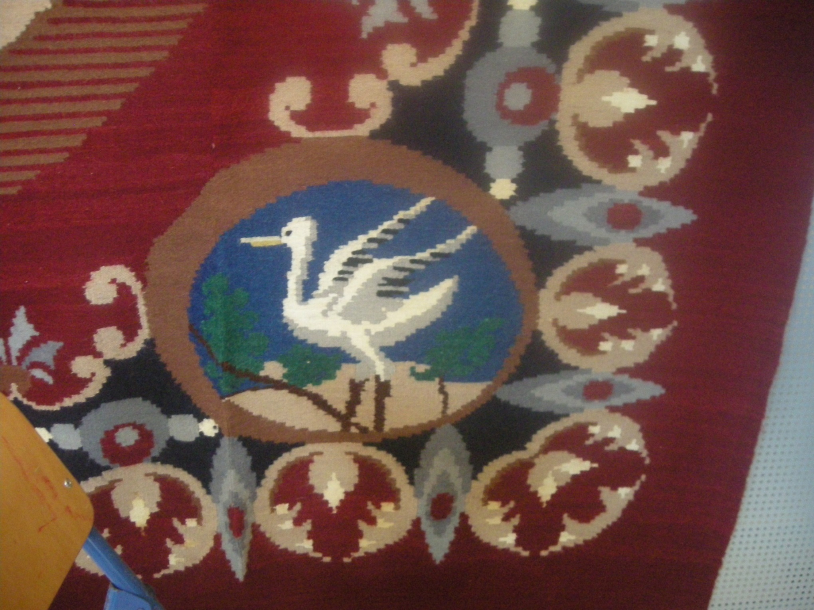

Slide 30
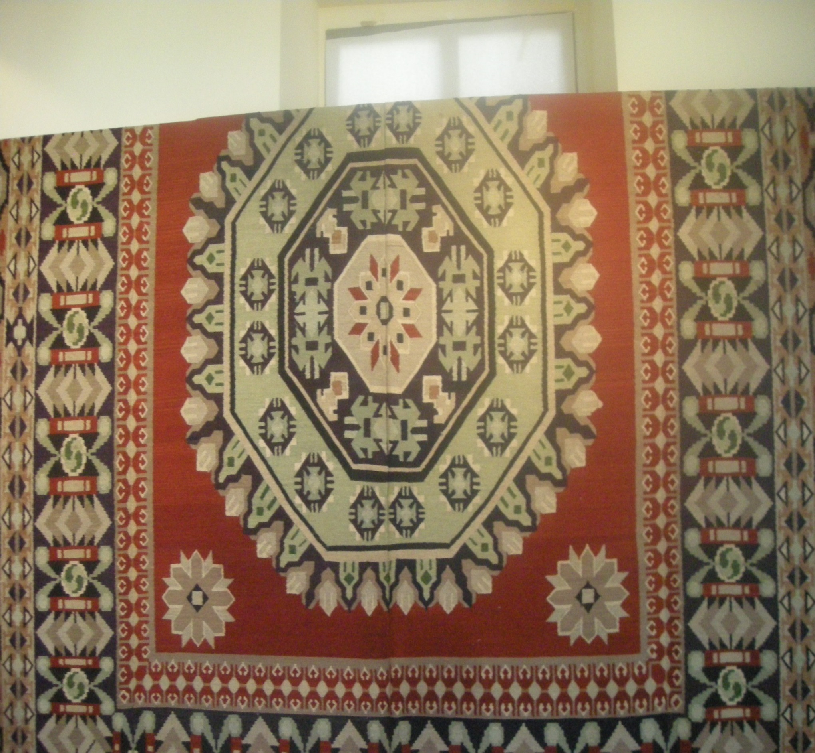

Slide 31
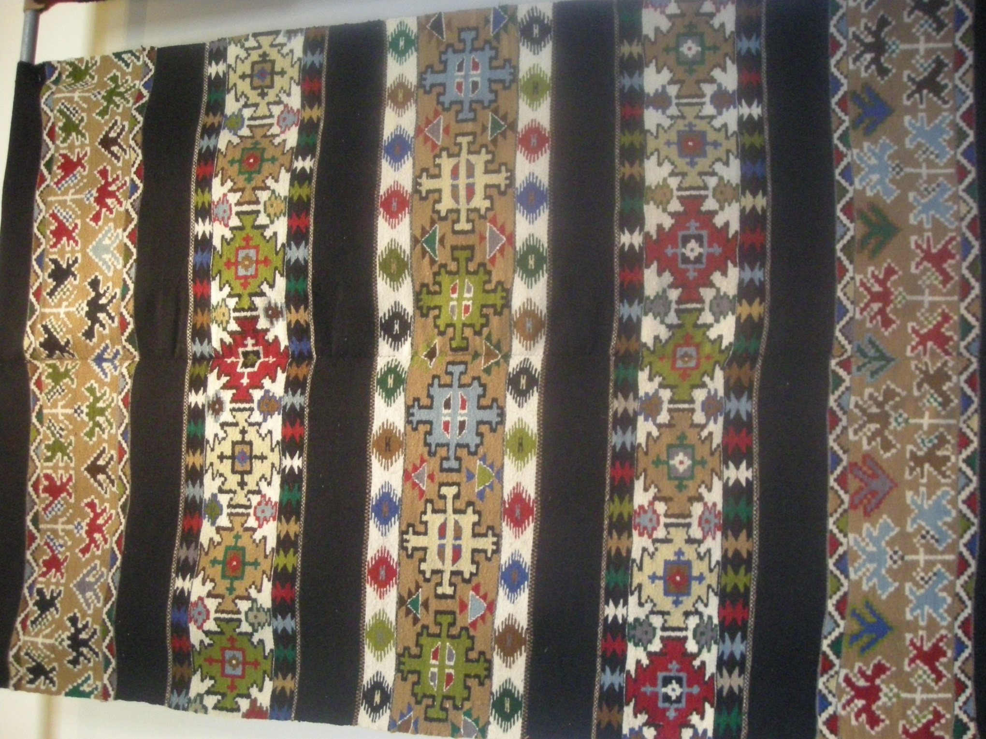

Slide 32
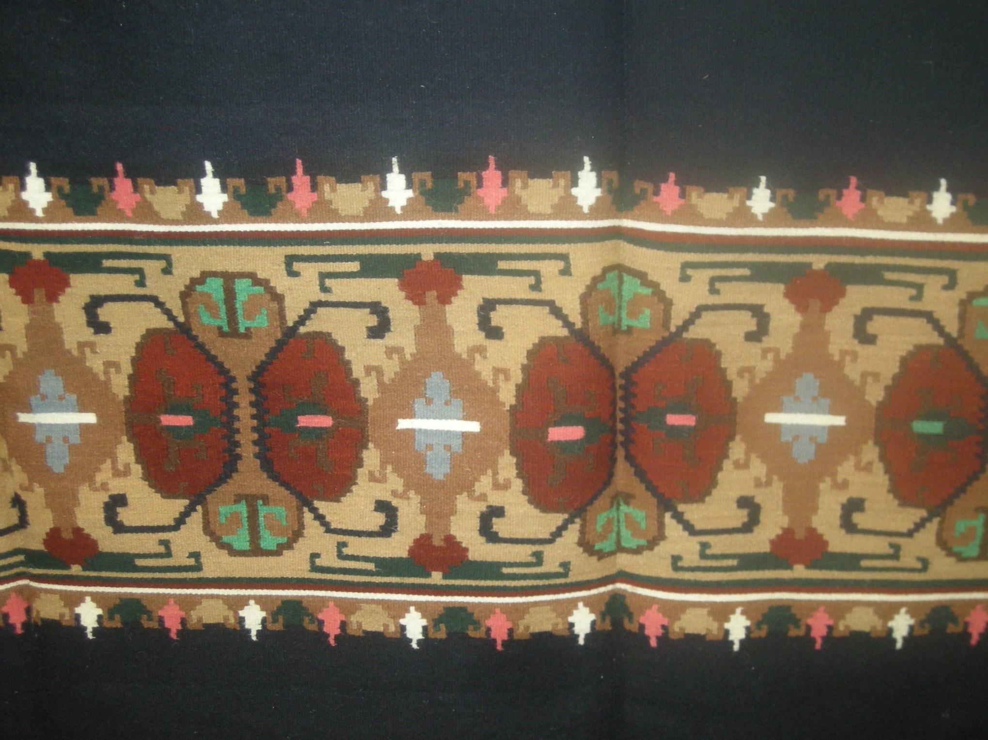

Slide 33
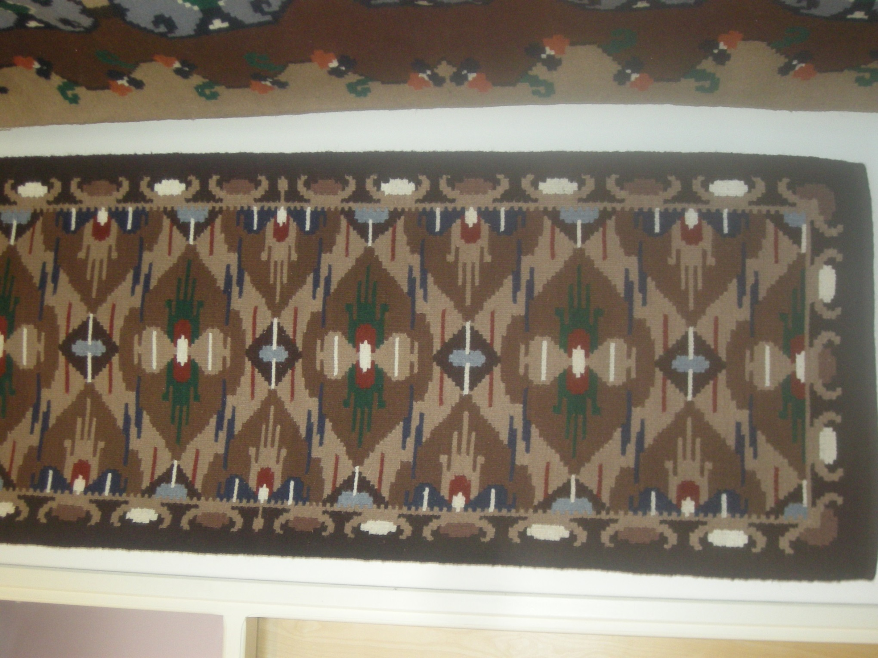

Slide 34
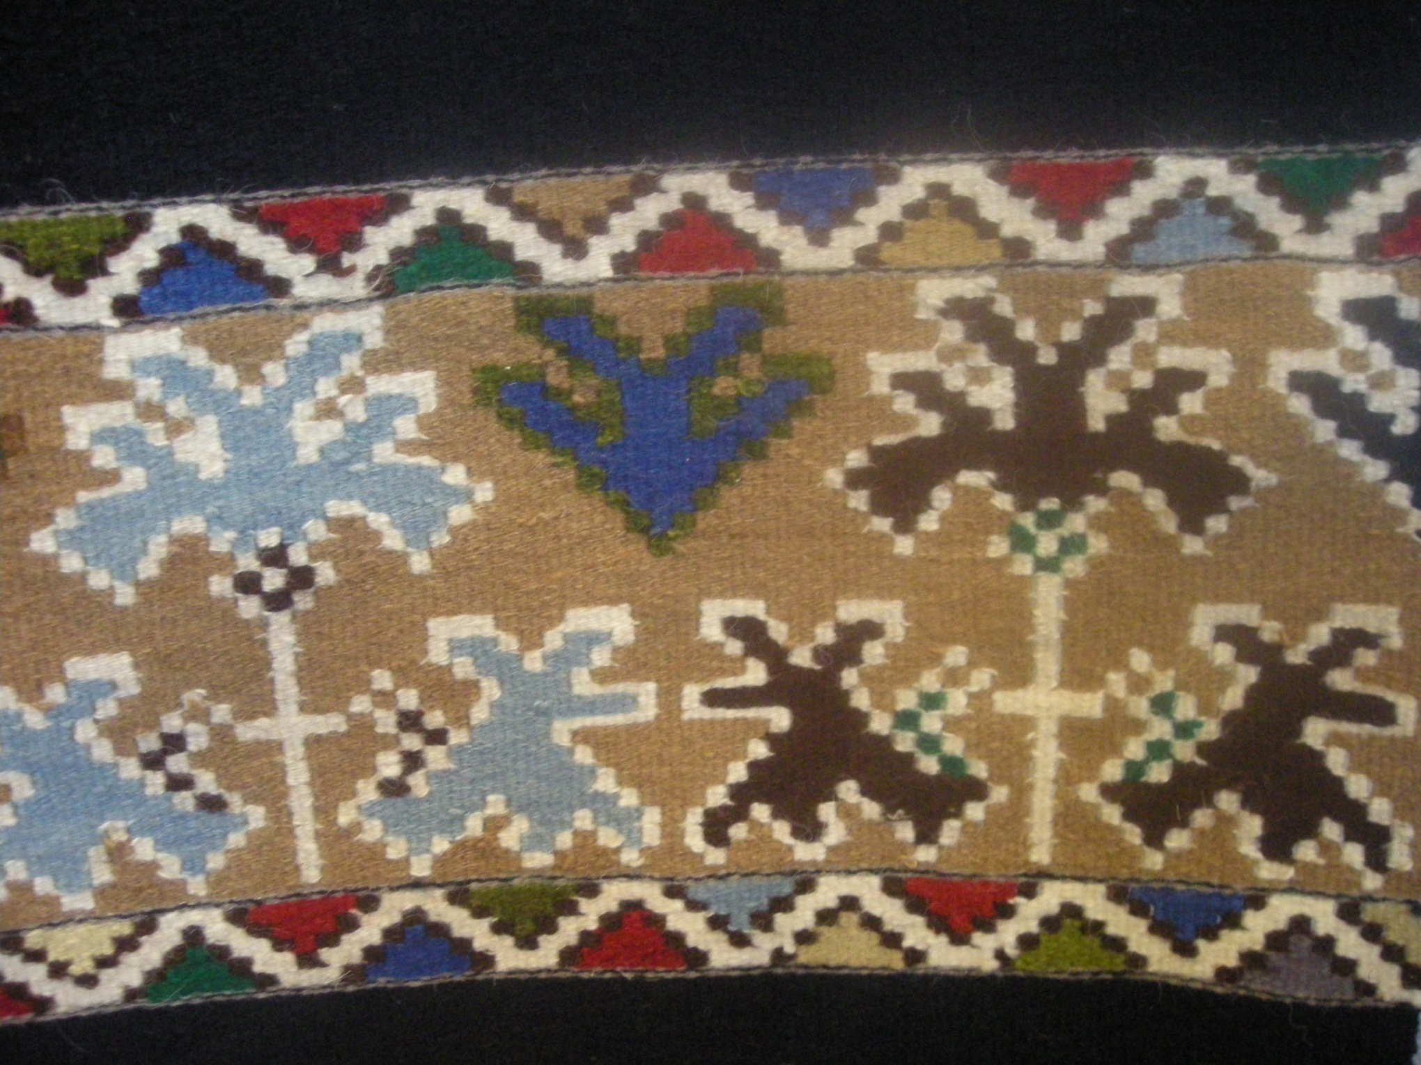

Slide 35
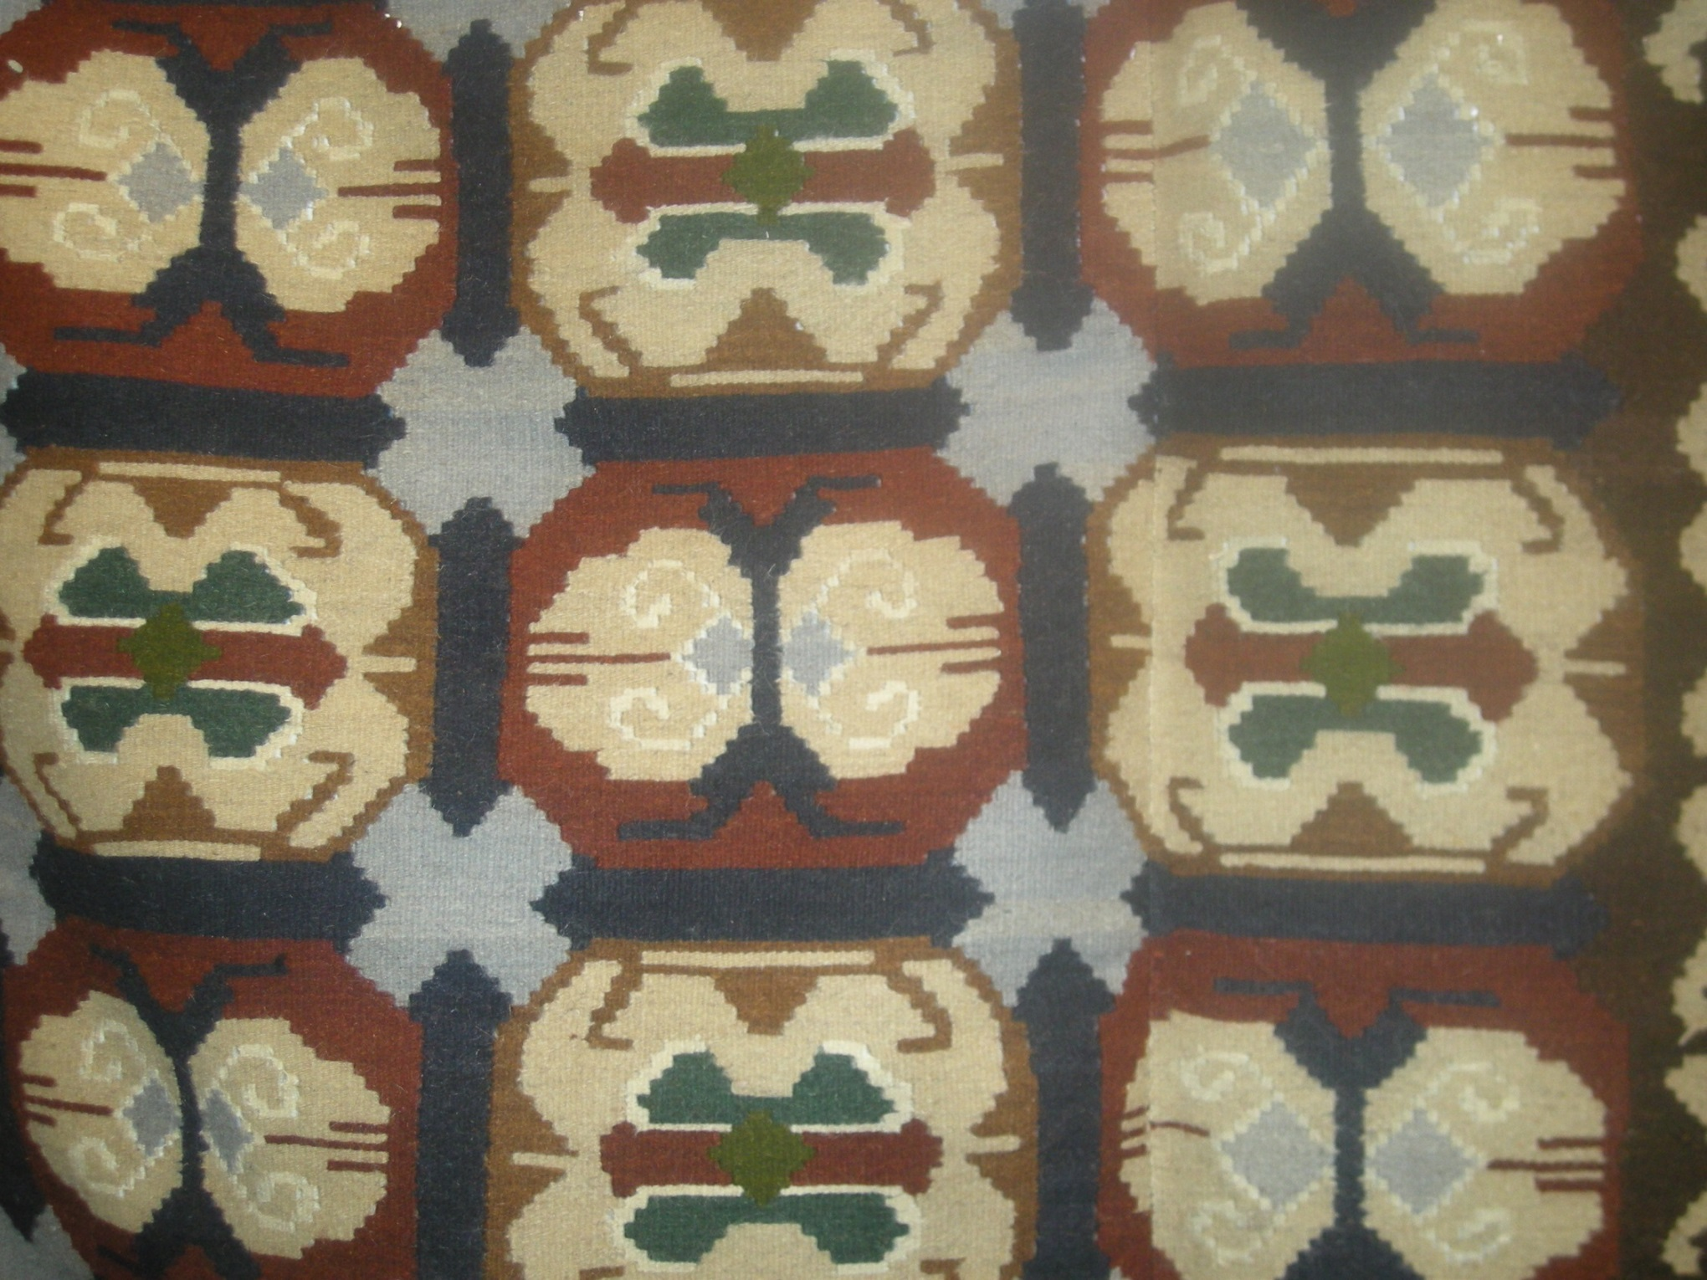

Slide 36
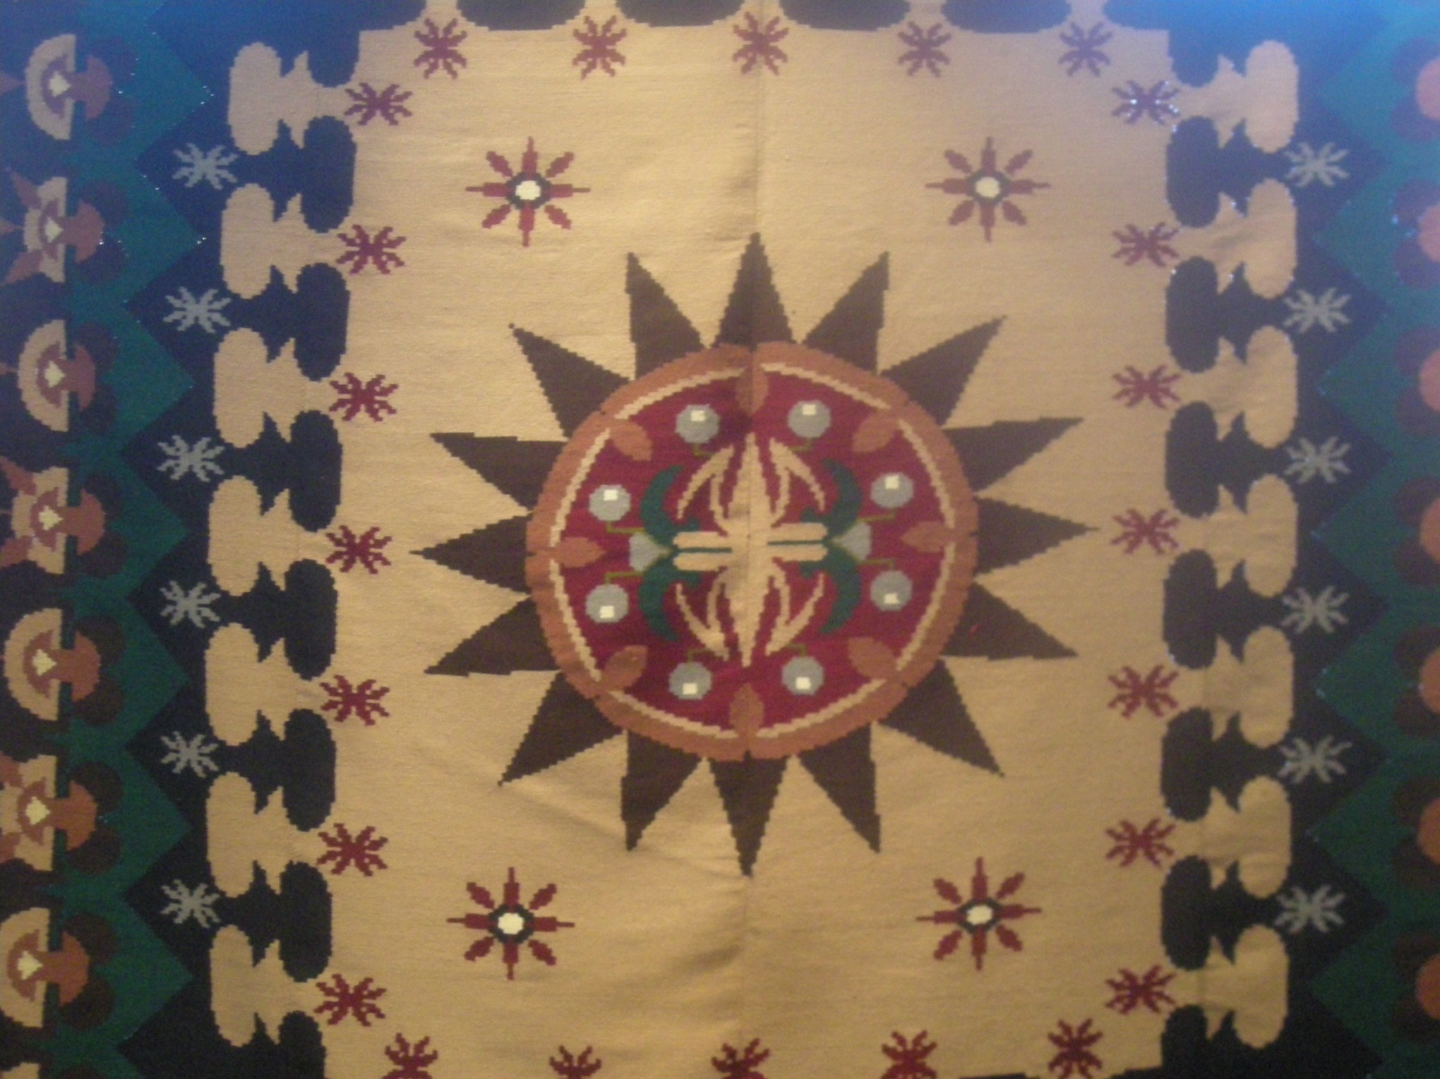

Slide 39
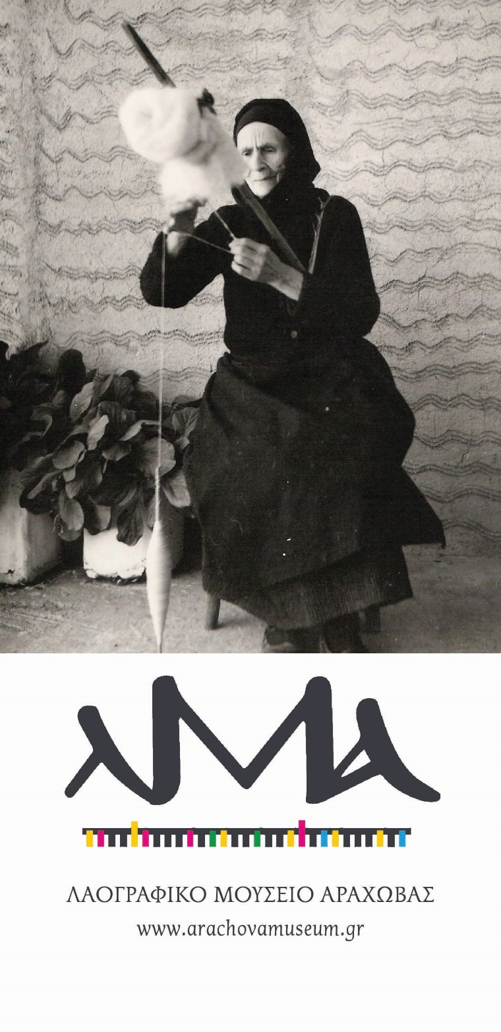

Slide 42
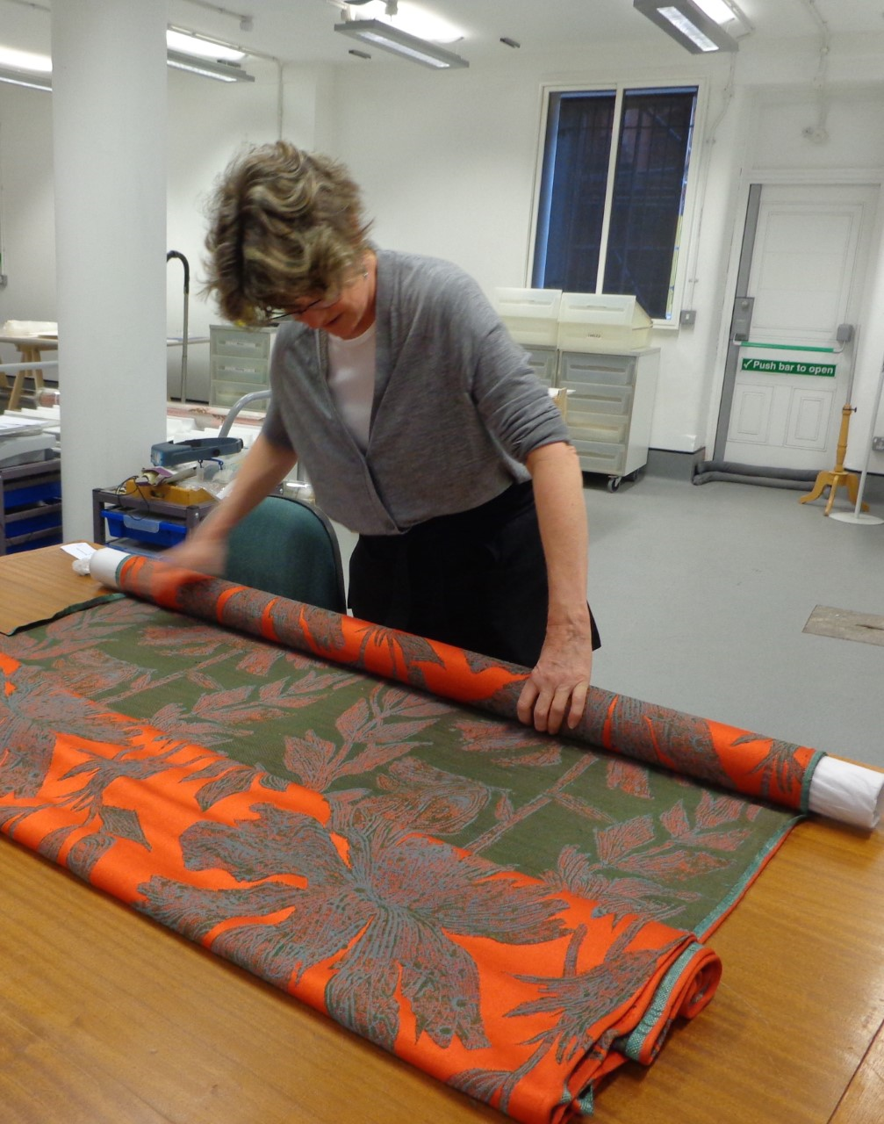
Λαογραφικό Μουσείο Αράχοβας

Slide 43
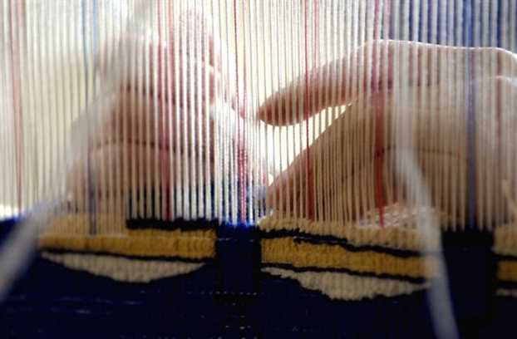
Πρόγραμμα Πηνελόπη Γκάντι

Slide 44
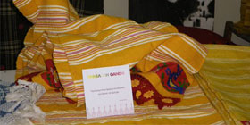

Slide 45
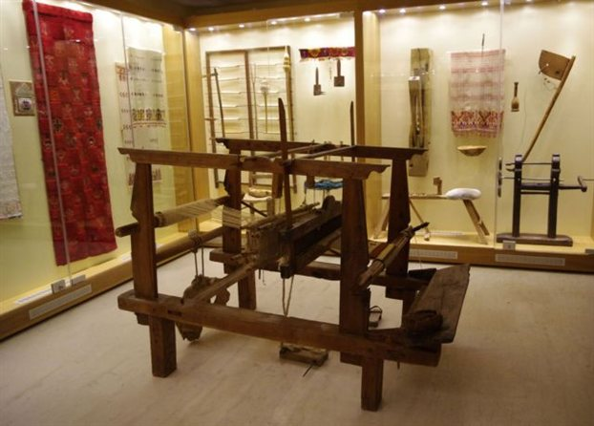
Πρόγραμμα Πηνελόπη Γκάντι

Slide 46
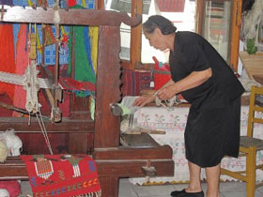
Πρόγραμμα Πηνελόπη Γκάντι

Slide 47
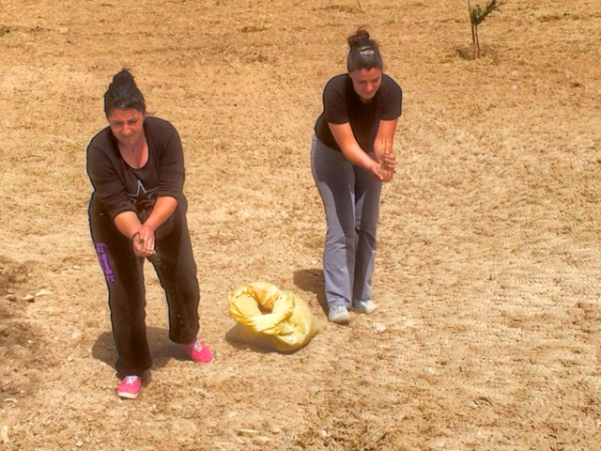
Σπορά Λιναριού - Γέργερη Ηρακλείου - Απρίλιος 2015

Slide 48
Ν.Δ. 3875 της 25/31-10-58 (Α 182). Περί συστάσεως
Εθνικού Οργανισμού Ελληνικής Χειροτεχνίας.
Ν. 707/1977 (Α` 273 περί ενοποιήσεως του Εθνικού Οργανισμού Ελληνικής Χειροτεχνίας (ΕΟΕΧ) και του και του Κέντρου Βιοτεχνικής Αναπτύξεως (ΚΕΒΑ) σε ενιαίο, κοινωφελούς χαρακτήρος οργανισμόν, υπό την επωνυμία
"ΕΛΛΗΝΙΚΟΣ ΟΡΓΑΝΙΣΜΟΣ ΜΙΚΡΟΜΕΣΑΙΩΝ ΜΕΤΑΠΟΙΗΤΙΚΩΝ ΕΠΙΧΕΙΡΗΣΕΩΝ ΚΑΙ ΧΕΙΡΟΤΕΝΙΑΣ (Ε.Ο.Μ.Μ.Ε.Χ.) και εν συνεχεία "ΕΛΛΗΝΙΚΟΣ ΟΡΓΑΝΙΣΜΟΣ ΜΙΚΡΩΝ - ΜΕΣΑΙΩΝ ΕΠΙΧΕΙΡΗΣΕΩΝ ΚΑΙ ΧΕΙΡΟΤΕΧΝΙΑΣ" (Ε.Ο.Μ.Μ.Ε.Χ.) κατά Νόμον 2000/1991 (Α` 206).

Slide 49
Σκοποί του ΕΟΜΜΕΧ
α) την δια παντός μέσου και δια συντονισμού των επί μέρους προσπαθειών των ενδιαφερομέ-νων, διάσωσιν των ποικίλων μορφών της Ελληνικής Λαϊκής Τέχνης, ως αύται εκφράζονται δια των αντικειμένων της εγχωρίου χωρικής και αστικής χειροτεχνίας οικοτεχνίας και βιοτεχνίας,
β) την περαιτέρω βελτίωσιν αναπροσαρμογήν και ανάπτυξιν αυτών,
γ) την οργάνωσιν αύξησιν και βελτίωσιν της παραγωγής τούτων, ως και την οργάνωσιν και προώθησιν της καταναλώσεως των παραγομένων προϊόντων εις το εσωτερικόν και το εξωτερικόν.

Slide 50
ΕΟΜΜΕΧ Βάση Δεδομένων Παραδοσιακών Χειροτεχνιών
Συστέμα Πληροφορική Α.Ε.

Slide 56
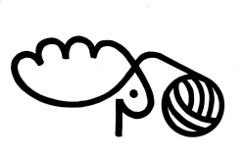
European meeting "Wool scouring in Europe: Urgent and ecological solutions"
Date of event:
03.11.2015
The ATELIER-Laines d’ Europe association would kindly like to invite you to the European meeting "Wool scouring in Europe: Urgent and ecological solutions". The meeting will take place in Saugues (Haute-Loire), in France, from 4th to 6th of November 2015.
Date of event:
03.11.2015
The ATELIER-Laines d’Europe association would kindly like to invite you to the European meeting "Wool scouring in Europe: Urgent and ecological solutions". The meeting will take place in Saugues (Haute-Loire), in France, from 4th to 6th of November 2015.

Slide 60
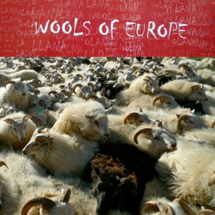
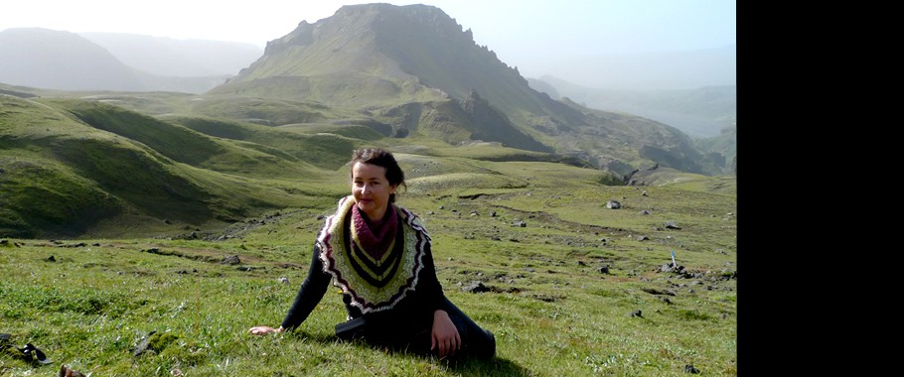
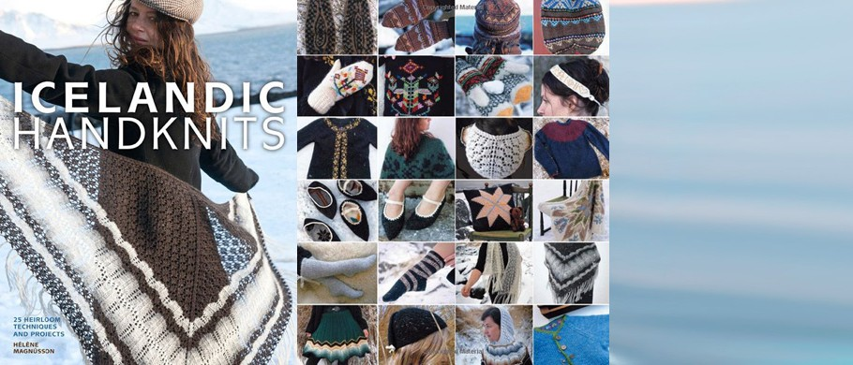
...
Wools of Europe « The Icelandic Knittezoom
To

Slide 61
Το περιοδικό
" ATELIER-Laines d‘ Europe"
κυκλοφορεί στα Γαλλικά δυό φορές το χρόνο, αλλά και στα Αγγλικά και Γερμανικά. Σε 64 σελίδες.
On 64 pages, one finds there articles technical, reports on the situation of wool in various countries, of the historical documents, a file of 4 pages on a topic chosen, a press review, advertisements and a calendar of exposures, fairs and shows .
 | Subscription
the new ATELIER magazine n° 24 was published in April 2015
see publications in French! One or twice per year,appears the magazine " ATELIER-Laines d'Europe" in french, but also sometimes in English or German. On 64 pages, one finds there articles technical , reports on the situation of wool in various countries, of the historical documents, a file of 4 pages on a topic chosen, a press review, advertisements and a calendar of exposures, fairs and shows .
Annual membership: -individual members 35 € - craftspeople: 50 € -associations, enterprises, ... 100 € (membership fees include a subscription to the bulletin) Form to be printed and then posted

Slide 62
Welcome to Renaissance Dyeing
The home of naturally plant dyed yarn and threads. We have a broad range of hand dyed shades and fibres to help you create in many different media, be it, embroidery, knitting, crochet, felting, natural dyeing, weaving or all together!
Featured products
Renaissance Crescent by Kieran Foley
A spectacularly colourful crescent shawl designed by Kieran Foley using Renaissance Dyeing naturally dyed blue-faced Leicester 4 ply wool.
Renaissance Stripes by Kieran Foley
Renaissance Stripes has been designed by Kieran Foley of Knit/Lab using 67 x 25 m skeins of Renaissance Dyeing's naturally dyed fine lace-weight wool.
Elizabethan range
Hand dyed Elizabethan Range of embroidery thread shades dyed using the mordants and natural dyes available in the 16th century.
Bohemian Rhapsody
Bohemian Rhapsody Wrap is a crocheted masterpiece designed by Mary Lena Lynx using all of the 75 colours of our main crewel range.
Frivolity Blue Tam by Kate Wallace
Frivolity Blues Tam by Kate Wallace: A wonderful Lace and Fairisle Tam designed in Ecru and 3 shades of Renaissance Dyeing indigo and owed dyed wool.
Main range
Renaissance Dyeing main range has 75 skeins x of fine crewel thread of 25m each. The mordants and dyestuffs used are vegetable, mineral and cochineal.
Welcome to Renaissance Dyeing
The home of naturally plant dyed yarn and threads. We have a broad range of hand dyed shades and fibres to help you create in many different media, be it, embroidery, knitting, crochet, felting, natural dyeing, weaving or all together!
Featured products
Renaissance Crescent by Kieran Foley
A spectacularly colourful crescent shawl designed by Kieran Foley using Renaissance Dyeing naturally dyed blue-faced Leicester 4 ply wool.
Renaissance Stripes by Kieran Foley
Renaissance Stripes has been designed by Kieran Foley of Knit/Lab using 67 x 25 m skeins of Renaissance Dyeing's naturally dyed fine lace-weight wool.
Elizabethan range
Hand dyed Elizabethan Range of embroidery thread shades dyed using the mordants and natural dyes available in the 16th century.
Bohemian Rhapsody
Bohemian Rhapsody Wrap is a crocheted masterpiece designed by Mary Lena Lynx using all of the 75 colours of our main crewel range.
Frivolity Blue Tam by Kate Wallace
Frivolity Blues Tam by Kate Wallace: A wonderful Lace and Fairisle Tam designed in Ecru and 3 shades of Renaissance Dyeing indigo and owed dyed wool.
Main range
Renaissance Dyeing main range has 75 skeins x of fine crewel thread of 25m each. The mordants and dyestuffs used are vegetable, mineral and cochineal.
Dyeing training courses by Andie Luijk
in Lieurac (Ariège)
"Renaissance Dyeing
Secrets of the natural dye garden: August 7th - 13th
Working with natural dye extracts:Sept 4th - 10th
Φυτικές βαφές

Slide 63
Φυτικές βαφές
Forum International de la Couleur Végétale
October 9, 2015
Couleur Garance in Lauris, Vaucluse (France)

Slide 64
5th North Atlantic native Sheep and Wool Conference

Slide 65
Black Sheep: The Darker Side of Felt
July 18 - October 3, 2016
Patform Gallery, à Clitheroe
Lancashire (United Kingdom)

Slide 66
Mostra sull'arte tessile di Alice Stransky
du 4 juillet au 18 octobre 2015
Museo dell'Arte della Lana
Pratovecchio Stia (Italy)

Slide 67
Wools of Europe in Musée Museum Départemental de Gap, 20 June - 26 September 2011

